Slide 1

Welcome to GEOG 3404 PYTHON in GIS
Instructor: Yanan Wu

Slide 2
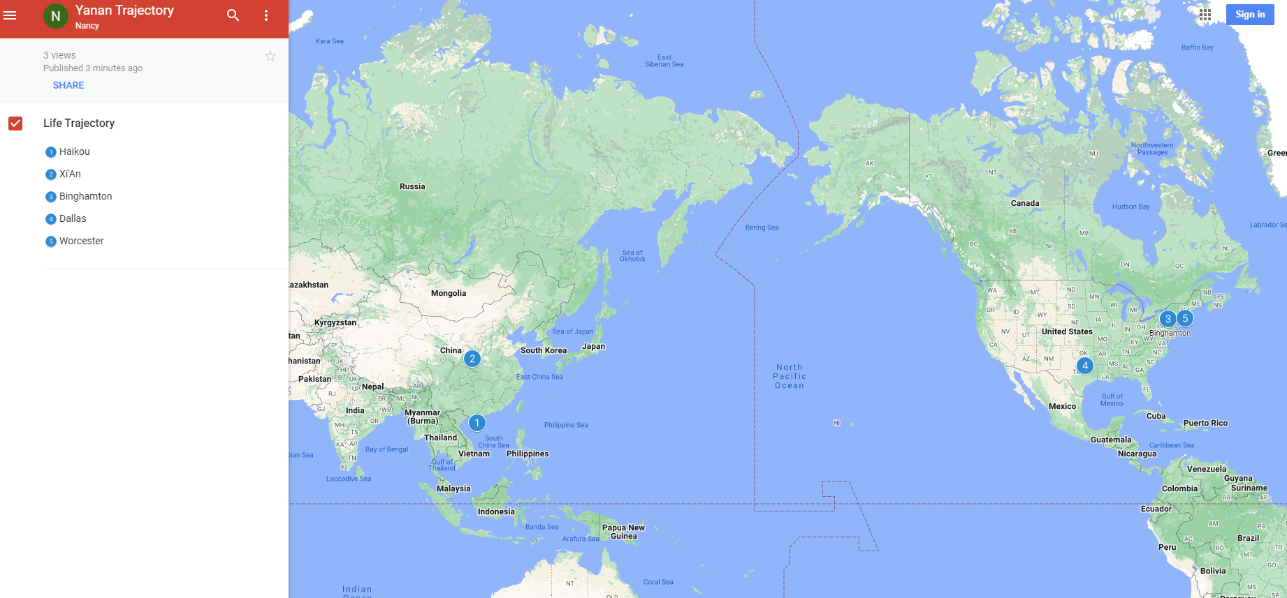
Yanan Wu – Assistant Professor
Education & Experience

Slide 3


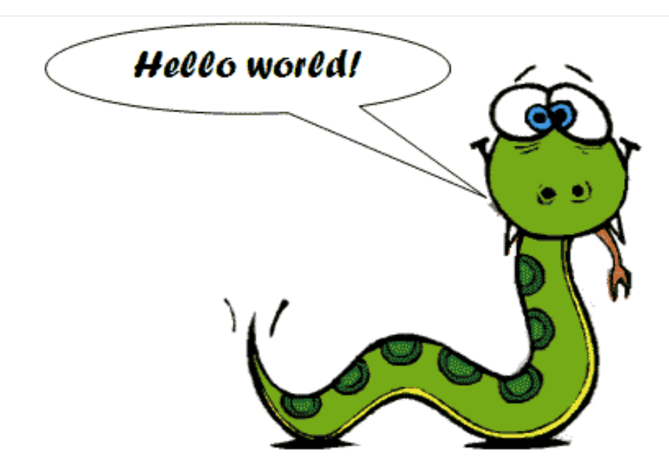



Teaching
Python Programming
Spatial Database
Intermediate Statistics
Manipulating Spatial Data
Web Mapping
Processing Raster
Data Analysis
Creating Custom Tool
Data Visualization
…
Geodatabase
SQL
Proximity Analysis
Geometry processing
Raster processing
PostSQL with python
…
Bivariate regression
Logistics regression
PCA
GWR
Spatial Autocorrelation
…

Slide 4
How about you?
Your background (e.g., name, major, where you come from)
What is your funniest thing that happened during your winter break?
What relevant experience do you have with python?
What are your expectations for this course?

Slide 5
Course Format
Lectures: Burdick 315
Thursday: 2:40 – 4: 00 pm
Labs: Burdick 315
Thursday: 4:00 – 5: 20 pm
Instructor Office Hours: Monday & Wednesday: 10: 00 – 11:59 AM
Instructor Office Location: Burdick 318B

Slide 6
IMPORTANT DATES
Mar 9 – 13
AI Tool in Programming
Mar 16-20
AAG Conference
Mar 23-27
Spring Break
Apr 13 - 17
Project analysis
Apr 20 - 24
Final Project Presentation
Apr 27 – May 1
Final Project Report

Slide 7
Course Requirements
Final project: 400 points in total
For 4-credit version of this course only
Design your own research, get your own data, process the data, generate maps, and write a final report
You can refer to the previous exercise to get help
Lab exercise: 500 points in total

Slide 8
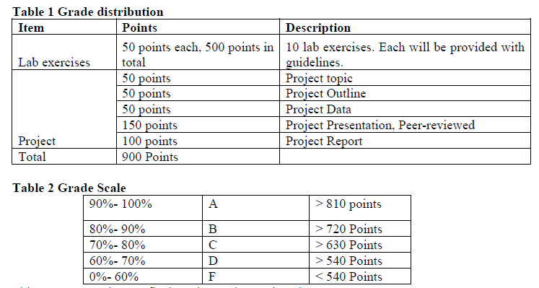
Grade

Slide 9
Textbook
Free Online learning source
Ujaval Gandhi (2024). Python Foundation for Spatial Analysis. https://courses.spatialthoughts.com/python-foundation.html
Dave Whipp (2023). Geo-Python 2023. https://geo-python-site.readthedocs.io
Qiusheng Wu (2023). Earth Engine and Geemap: Geospatial Data Science with Python. https://book.geemap.org
Non-open Source Textbook
Eric Pimpler, Programming ArcGIS Pro with Python, 2nd Edition

Slide 10
Why taking this class?
Our focus is on problem solving
Two module together
Exercise/project-oriented, not theory-oriented
We take care of what and how but not why!

Slide 11
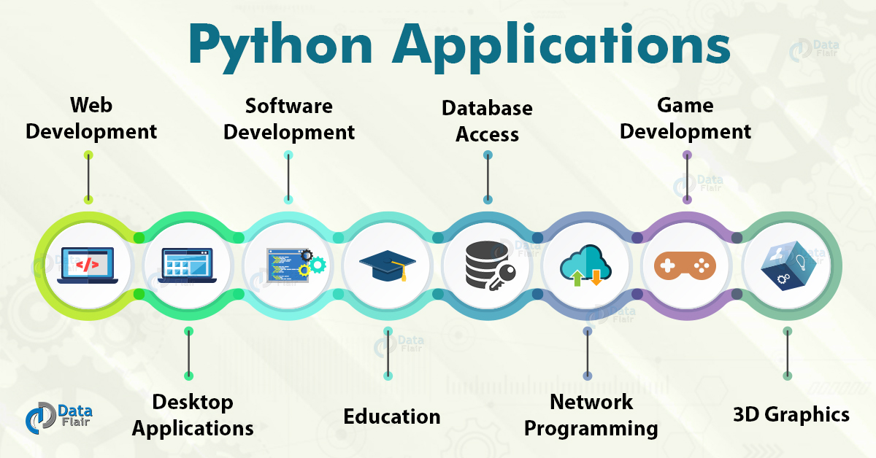
Overview

Slide 12
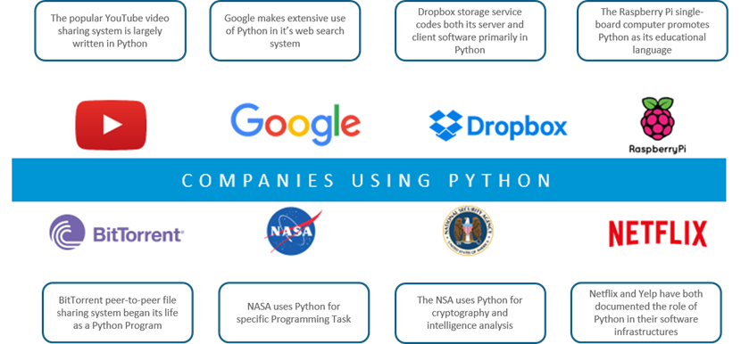

Slide 13
Why Programming?
Customize applications and tools
Reduce repetitive work
Access more functionality
Add new functionality / Extend GIS functionality into non-GIS applications

Slide 14
Why Python?
An open-source language
Packages, libraries, functions, resources…ALL FREE (Our textbooks have free versions as well)
GREAT documentation!
https://docs.python.org/3/
ArcPy (Not usable separately)
PyQGIS
Cross-platform

Slide 15
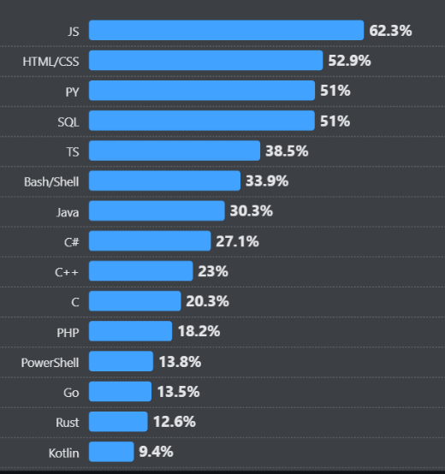
Source: survey.stackoverflow.co

Slide 16
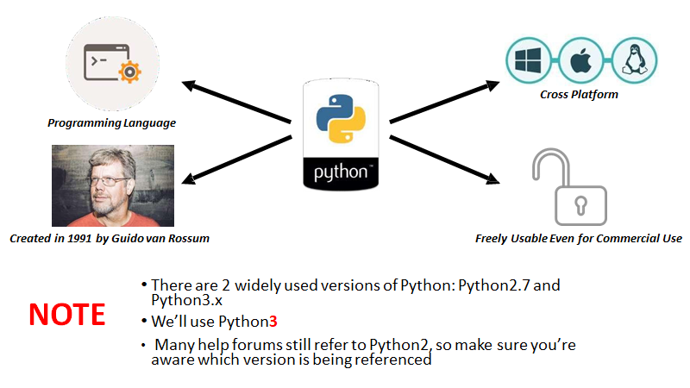

Slide 17
Python Version
Python versions
2.x up to 2.7, 3.x (currently 3.12.x)
Python 2.x is legacy, Python 3.x is the present and future of the language
3.x may have compatibility issue with other software
Be careful when you download different versions
Especially when you install external libraries and packages

Slide 18
One way to know the version of Python!
Command Prompt
Why this is important?
Different libraries
Functionality
Version reliability

Slide 19
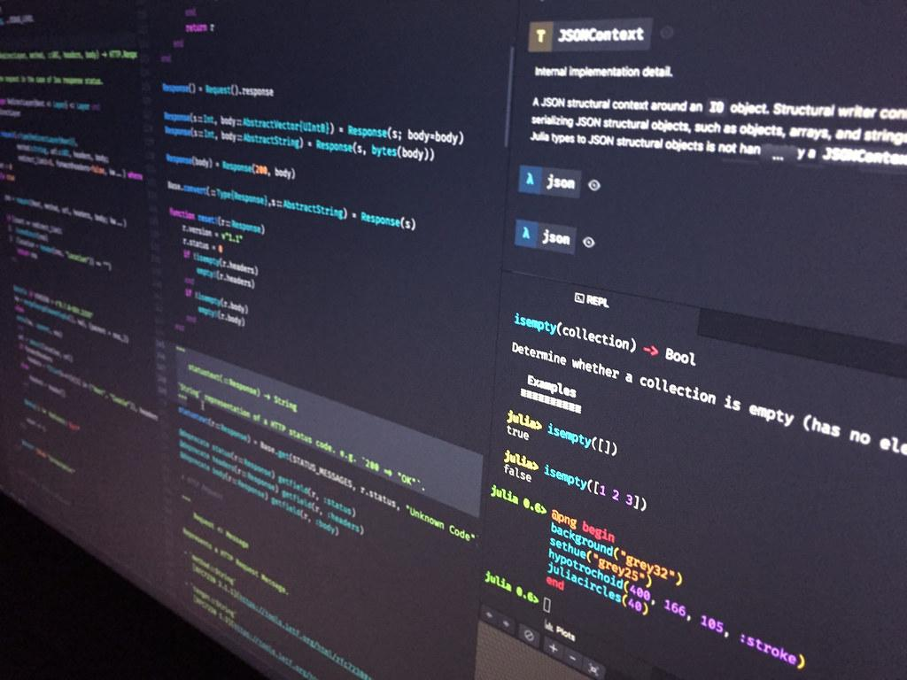
What if I do not want to deal with the command prompt?

Slide 20
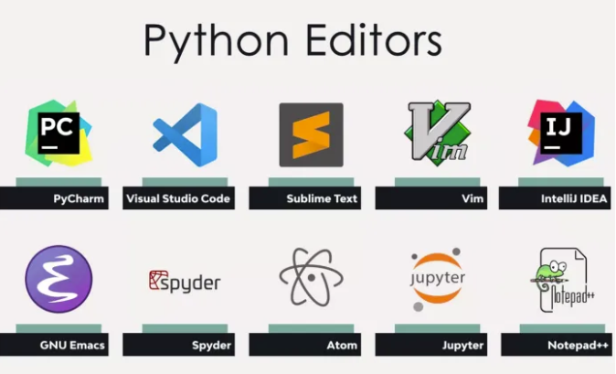
You can have both ways of writing python in most of text editors!
Source

Slide 21
Visual Studio Code (VS code)
Developed by Microsoft for Windows, Linux, macOS
Used with a variety of programming languages: Python, Java, JavaScript, C++
Various features: debugging, syntax highlighting, intelligent code completion, version control with Git
Download Link

Slide 22

How Do I Program In Python?
ANACONDA
An open-source Python distribution platform (Download link)
Manages packages and working environments

Slide 23

Google Colab
What we covered so far was based on the fact that you want to use your own computer as a Python interpreter!
What if I want to practice programming on the web?
Google Colab
Github (Not recommended for now!)

Slide 24
While Using Colab
A folder will be created automatically in your Google Drive

Slide 25
Python Fundamental
Python
Condition Statement
If, elif, else
Loops
For, while
Functions
Define, Return, Lambda
Data Structure
List, Tuples, Dictionaries, Strings
Modules and Packages
Import, Virtual Environment

Slide 26






Non-spatial data processing: Pandas
DataFrame Creation
Data Inspection
Data Selection
Data Cleaning
Data Manipulation

Slide 27
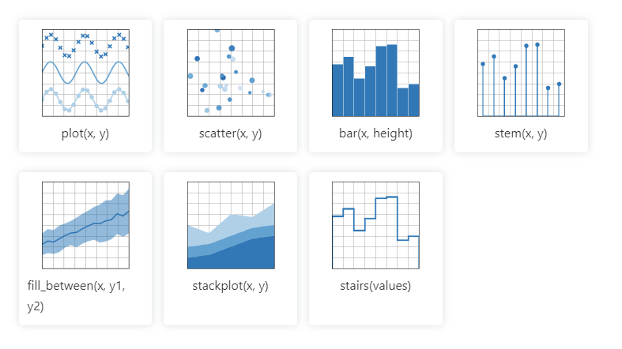
Data Visualization: Matplotlib
Matplotlib cheatsheets and handouts

Slide 28
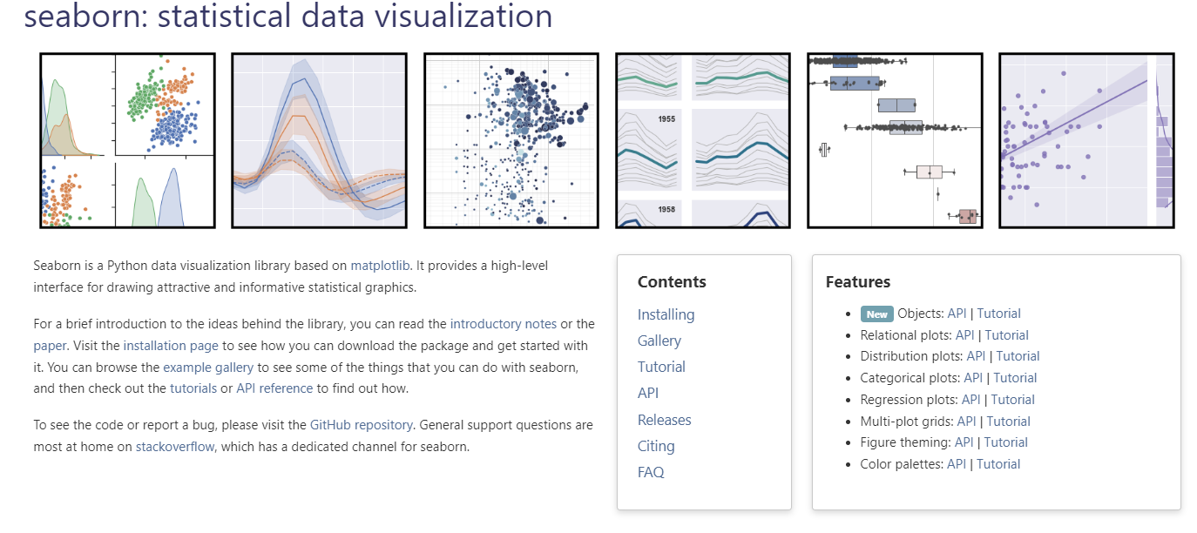
Data Visualization: seaborn
Seaborn cheatsheets and handouts

Slide 29
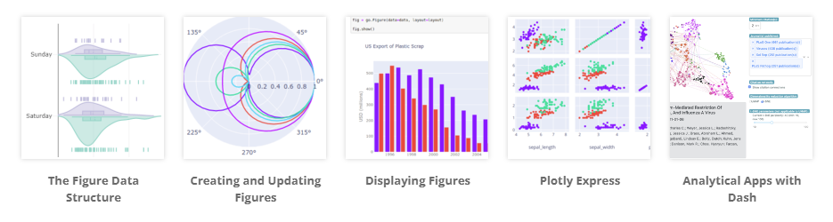
Data Visualization: plotly

Slide 30
Difference among three
plotly
seaborn
matplotlib
matplotlib: Low-level library
seaborn: built on top of matplotlib
plotly: focused on interactive plots

Slide 31
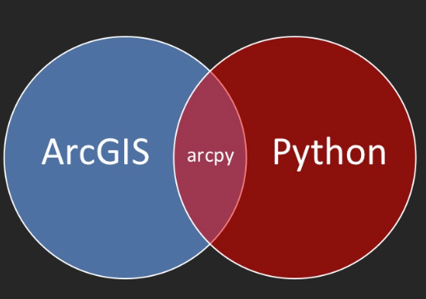
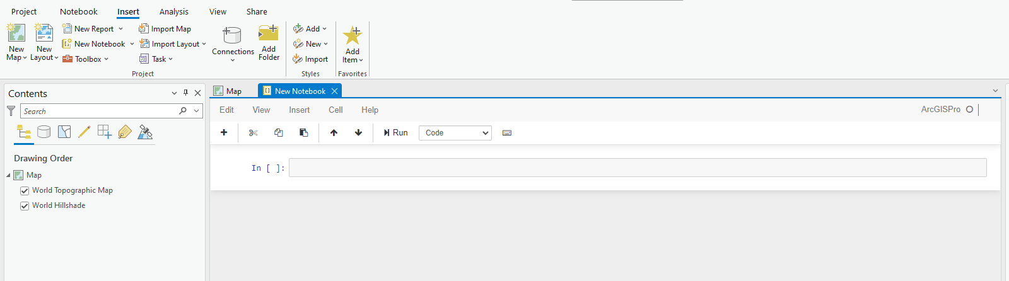

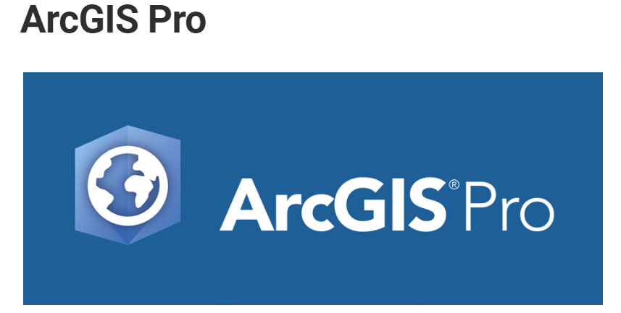
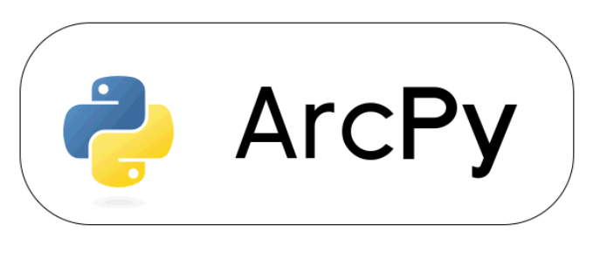
Geoprocessing - Arcpy
Integration with ArcGIS Pro
Scripting & Automation
Access to Geoprocessing Tools
Interact with other Esri products

Slide 32
Web maps using the ArcGIS API for Python
Esri User Document
Esri official Repo on GitHub

Slide 33
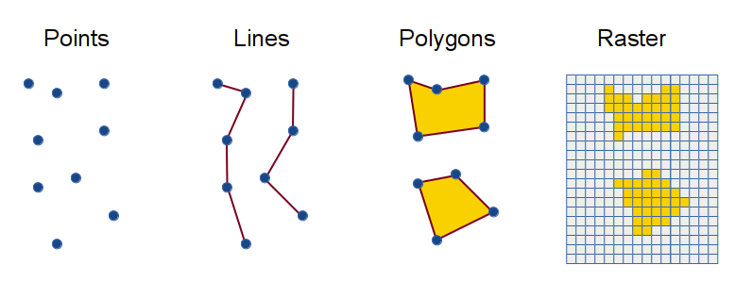
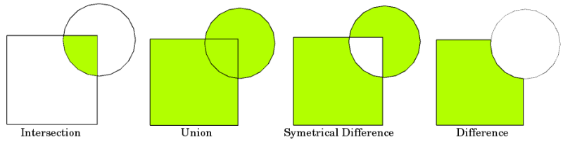
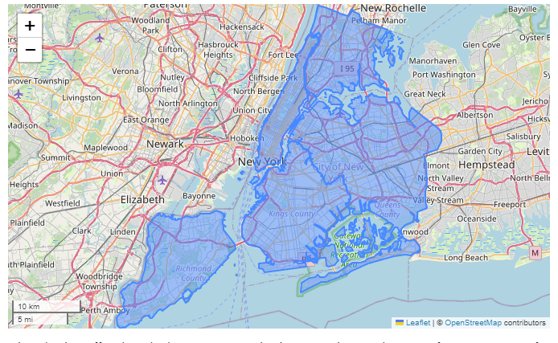
Web maps using the Open Source Spatial Libraries
Spatial Data Structure
Geometric Operation
Interactive map
Open Source
Installing with Anaconda/conda

Slide 34
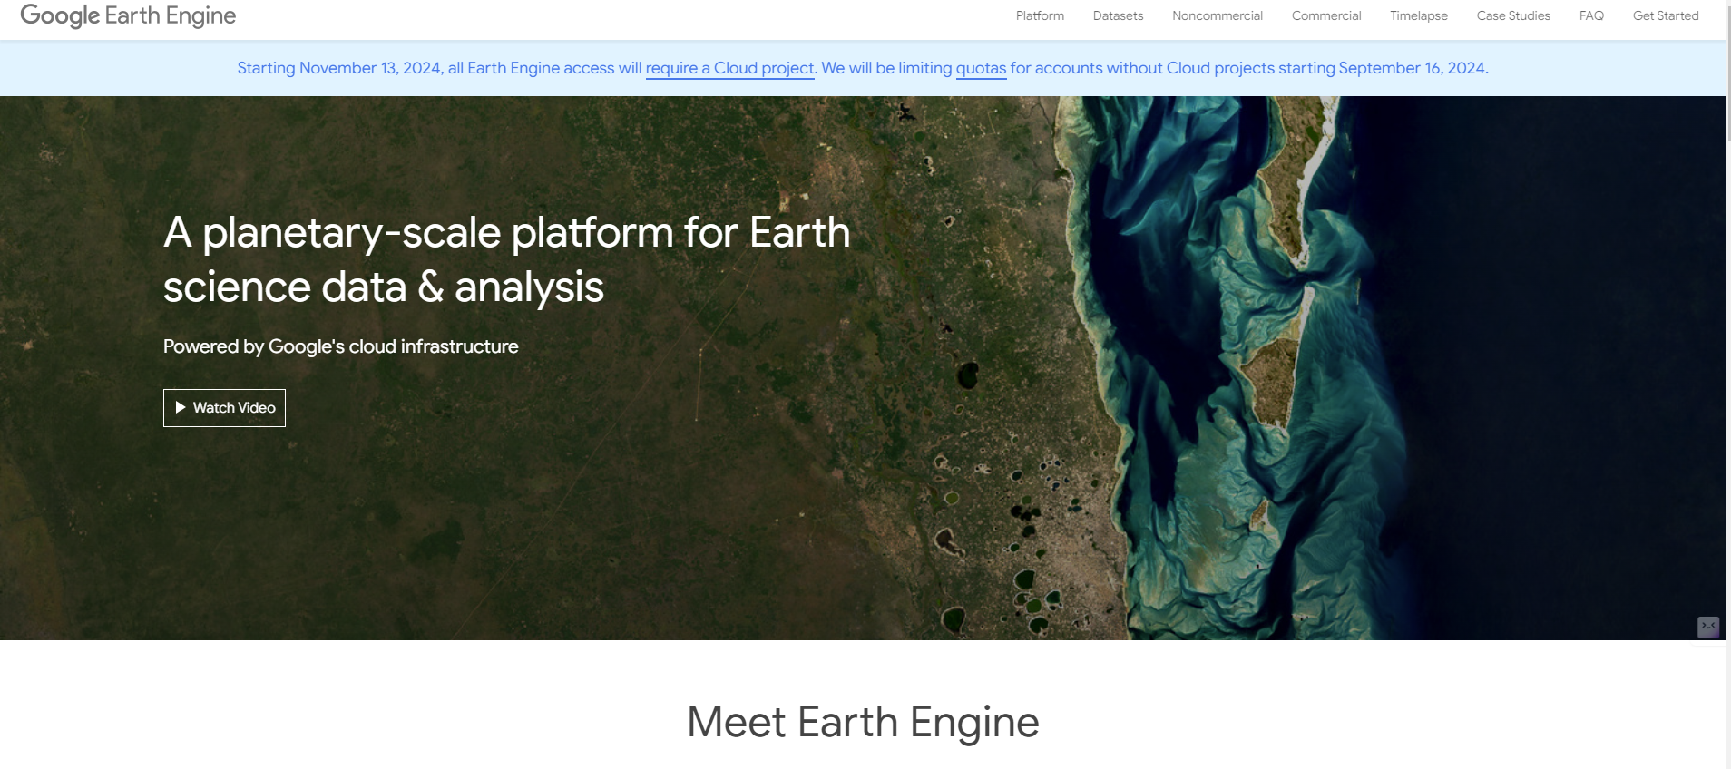
geemap – Google Earth Engine Python API

Slide 35
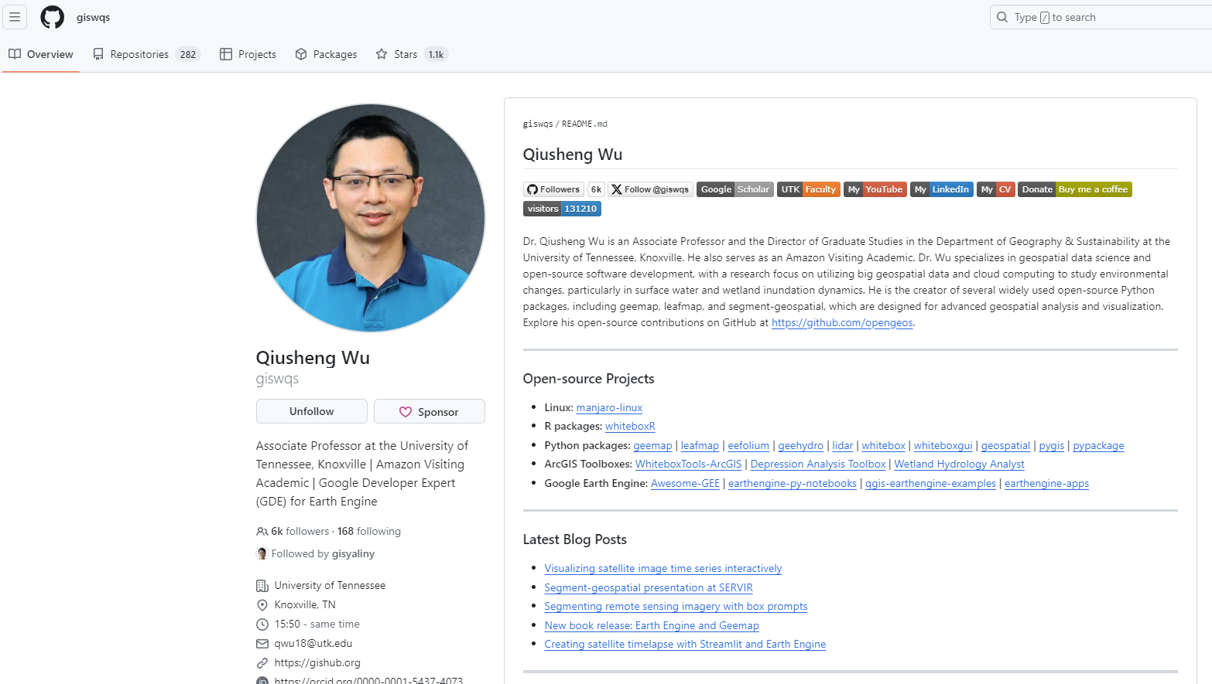
geemap – Google Earth Engine Python API

Slide 36
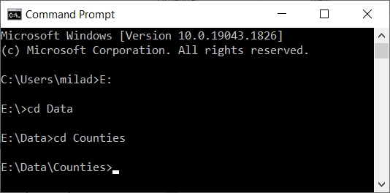
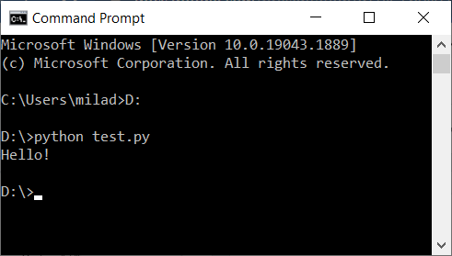
How Do I Program In Python?
Two Main Ways (You should add python to the system variable):
Normal mode (Script Mode)
Write your code in a file (it could be any type of file:txt,word) and save it with the .py extension
Execute the file by using the shell (terminal, CMD, Command Prompt): The picture on the right
You need to direct the shell to where you have the code saved:
If the file (your code) is stored directly in a Drive (in my case it is saved in D drive) you will use the following command: D:
If the file is stored in a nested folder (e.g., “E:\Data\Counties”) then you need to use the cd command: The picture on the left

Slide 37
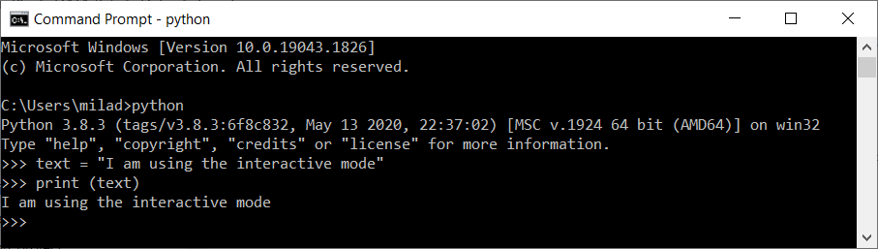
How Do I Program In Python?
The other way:
Interactive mode (interacting directly with the interpreter)
Bring up a terminal (command prompt, shell)
Type python
After the info about the version the cursor will transform to >>>
Start writing your code
After each time you press Enter on your keyboard the command line goes to the next line and if there is something to be executed it will be executed:

Slide 38
Interactive Mode
Start writing in the python interpreter of your chosen python editor.
Pay attention to the indentation
>>> the_world_is_flat = True
>>> if the_world_is_flat:
... print("Be careful not to fall off!")
...
Be careful not to fall off!

Slide 39
Conclusion
Class Schedule
Topics for this course
Command prompt

Slide 40
Next
Install Visual Studio Code
Install Anaconda
Set up environment in VS Code

